Slide 1
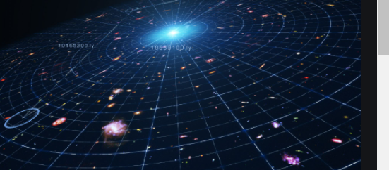
Fermi Paradox
Students Name
Institutional Affiliation
Due Date
Life Beyond Earth

Slide 2
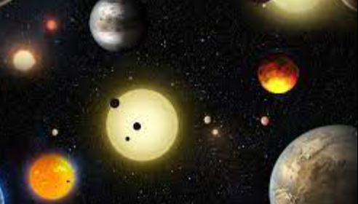
The Fermi Paradox
The fermi paradox is named after an Italian- American physicist one Enrico Fermi.
The paradox is described as a contradiction between extraterrestrial life evidence and the available high estimates for their probability (Manikutty, 2021).
The graphical presentation below is an Arecibo message of the first humanity attempt in using radio waves to communicate its existence to the civilization of Aliens.

Slide 3
Evidence of Intelligence-life Beyond Earth
According to Fermi, within the 4.4 billion years it took for intelligent life to exists on earth, the rest of the galaxy need to have been overrun with smart technology advanced aliens
however, scientists have monitored radio waves for any signs of aliens in the universe for decades but nothing has been found (Gray, 2015).
The conundrum is what is referred to as the Fermi Paradox
Other evidence suggests that aliens are hibernating creatures which means they can be hiding from humans deliberately.
Relatively, highly advanced technology civilizations get destroyed before they have an opportunity to get in contact with the other intelligent life based in the universe.

Slide 4
Why There is No Evidence of Intelligence
Humanity has attempted to send Arecibo messages using radio waves to communicate its existence to the civilization of Aliens .
However, because human beings are using the radio wave technology for about a century, as compared to the age of earth in four billion years. Even though there might be someone out there, opportunity window to have a similar technology is incredibly small.
Besides, the radio wave as it is known if for communication purposes.
Ideally it is changing from analogue to digital which is a complex signal to be detected
In this regard, the waves that the scientist are trying to find might be the wrong ones.
While the bigger wave spectrum is being analyzed, it is still a small fraction to establish the possibility of Aliens.

Slide 5
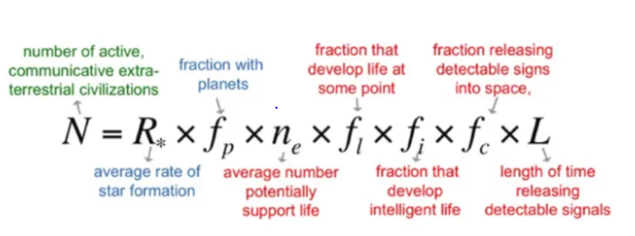
Drake Formula
In the year 1961, Frank Drake an astronomer developed a formula which multiplied about seven parameters in estimating the N, which is the number of detectable civilizations that can be expected in the galaxy anytime (Drake, 2019).
The drake equation is a rough tool used in stimulating scientific discussions around the possibility of extraterrestrial life.
However in the absence of a reliable alternative, it is the only method astronomers can use in calculating the possibility of extraterrestrial intelligence.

Slide 6
Summary
There have been many attempts in explaining the Fermi paradox.
Most of which has suggested the extraterrestrial beings exists but are rare.
The lifetime of such civilizations is short or they exists for various reasons but there is no clear evidence
Both Fermi theory and the Drake Equation have attempted to prove the existence of aliens
Still there are gaps in the research and mode of communications in reaching the alien civilization.

Slide 7
References
Drake, F. (2019). Space missions for SETI. Acta Astronautica, 44(2-4), 113-115. https://doi.org/10.1016/s0094-5765(99)00036-3
Gray, R. (2015). The Fermi Paradox Is Neither Fermi's Nor a Paradox. Astrobiology, 15(3), 195-199. https://doi.org/10.1089/ast.2014.1247
Manikutty, A. (2021). TWO NEW ANSWERS TO THE FERMI PARADOX. SSRN Electronic Journal. https://doi.org/10.2139/ssrn.3809937

